Slide 1

Google App Engine Tutorial
Joe Gregorio
Developer Advocate
Google App Engine
Joe Gregorio
Developer Advocate
Google App Engine

Slide 2
Application Configuration
Static Files, Scripts, Login, Logout

Slide 3
Configuration
tools/configuration.html
tutorial1

Slide 4

Modify 'app.yaml'
application: jcgregorio-test
version: 1
runtime: python
api_version: 1
handlers:
- url: /
static_files: index.html
upload: index.html
Resolves one of the biggest pain points in web development.

Slide 5
Run Development Server
$ cd google_appengine/tutorial1/
~/Desktop/google_appengine/tutorial1
$ python ../dev_appserver.py .
INFO 2009-03-05...

Slide 6
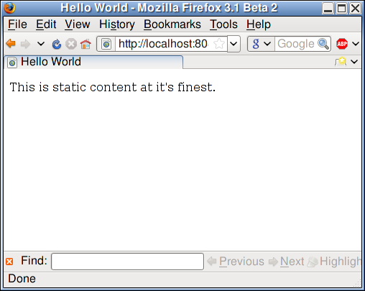
Run Development Server

Slide 7
login: (admin | required )
application: jcgregorio-test
version: 1
runtime: python
api_version: 1
handlers:
- url: /
static_files: index.html
upload: index.html
login: admin
Practice: Try login: required

Slide 8
Modify 'app.yaml'
application: jcgregorio-test
version: 1
runtime: python
api_version: 1
handlers:
- url: /
static_files: index.html
upload: index.html

Slide 9
Uncached by default
$ curl --include http://localhost:8080/
HTTP/1.0 200
Server: Development/1.0
Date: Fri, 06 Mar 2009 15:59:05 GMT
Content-type: text/html
Cache-Control: no-cache
Content-Length: 155
<!DOCTYPE HTML>
<html>

Slide 10
expiration: [NNNd] [NNNh] [NNNm] [NNNs]
application: jcgregorio-test
version: 1
runtime: python
api_version: 1
handlers:
- url: /
static_files: index.html
upload: index.html
expiration: 2d
Practice: expiration: [NNNd] [NNNh] [NNNm] [NNNs]

Slide 11
Check it out
$ curl --include http://localhost:8080/
HTTP/1.0 200
Server: Development/1.0
Date: Fri, 06 Mar 2009 17:32:44 GMT
Content-type: text/html
Expires: Mon, 09 Mar 2009 17:32:44 GMT
Cache-Control: public, max-age=259200
Content-Length: 155
<!DOCTYPE HTML>
<html>

Slide 12
static_dir
application: jcgregorio-test
version: 1
runtime: python
api_version: 1
handlers:
- url: /
static_files: index.html
upload: index.html
expiration: 2d
- url: /images
static_dir: images

Slide 13
Notes
Mime-type
Guessed by extension
Can be over-ridden
Order
Processed from top to bottom
Files that shouldn't be uploaded
skip_files:
Reserved URLs
/_ah/
/form

Slide 14
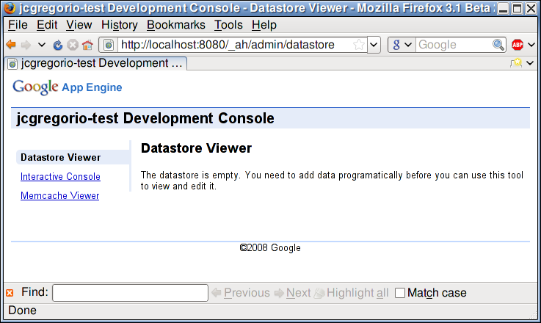
Local Admin
http://localhost:8080/_ah/admin

Slide 15
script:
application: jcgregorio-test
version: 1
runtime: python
api_version: 1
handlers:
- url: /
static_files: index.html
upload: index.html
expiration: 2d
- url: .*
script: main.py

Slide 16
main.py
#!/usr/bin/env python
print "Status: 200 OK"
print "Content-Type: text/plain"
print ""
print "Hi!"

Slide 17
Check it out`
$ curl --include http://localhost:8080/foo
HTTP/1.0 200 OK
Server: Development/1.0
Date: Fri, 06 Mar 2009 18:23:06 GMT
Content-Type: text/plain
Cache-Control: no-cache
Content-Length: 4
Hi!

Slide 18
Notes
CGI
App Engine presents a CGI
environment.
* Stateless
* 10 MB Limit
* 30s per request
* No streaming

Slide 19
secure: (never|always|optional)
application: jcgregorio-test
version: 1
runtime: python
api_version: 1
handlers:
- url: /
static_files: index.html
upload: index.html
- url: .*
script: main.py
secure: always

Slide 20
Thank You
Questions?

